Slide 1

Healthcare Predictive Analytics Project

Slide 2

Project Overview: Enhancing Healthcare Outcomes
This project centers on developing an advanced predictive model to revolutionize healthcare outcomes through data-driven insights. Our primary goal is to empower healthcare professionals with precise tools for tasks such as patient risk prediction, enabling more proactive and personalized care.
Omar Hammed
Mohammed Awad
Team Leader
ML Engineer
John Hosny
Mohammed Aziz
Data Scientist
Data Analyst
Mohammed Nagaty
Mahmoud Salah
Deployment Specialist
Documentation Lead

Slide 3

Core Objectives & Essential Technologies
Project Objectives
Key Tools and Technologies
Our aim is to create a robust, clear, and concise learning model. This model will function as an intelligent healthcare tracker or an advanced health agent API system, specifically designed for seamless integration and deployment within a Power BI environment. This will provide actionable insights directly to end-users.
To achieve our project goals, we leverage a comprehensive suite of industry-standard tools and technologies:
Anaconda Distribution: For a powerful data science environment.
PyCharm: Our integrated development environment for robust coding.
GIT: For version control and collaborative development.

Slide 4
Strategic Project Milestones
Data Collection, Exploration & Preprocessing
Finished by: Saturday, September 27, 2025
Advanced Data Analysis, Visualization & Feature Engineering
Finished by: Saturday, October 18, 2025
Model Development & Optimization
Finished by: Saturday, November 8, 2025
MLOps, Deployment & Monitoring
Finished by: Tuesday, November 25, 2025
Final Documentation & Presentation
Finished by: Monday, December 29, 2025

Slide 5
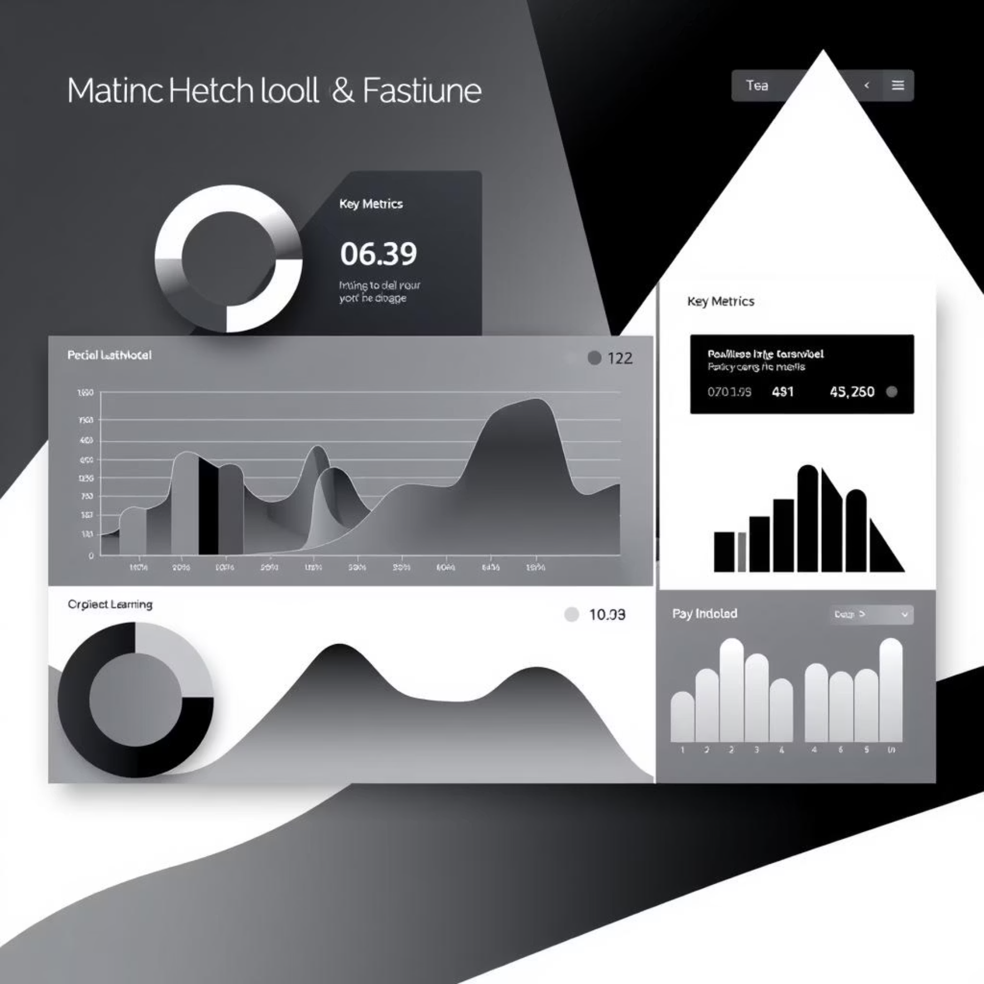

Data Quality & Model Performance Metrics
Data Quality Assessment
Model Performance Evaluation
Ensuring high-quality data is foundational for accurate predictions.
Our predictive model demonstrates strong performance across key metrics.
Missing Values Handled: 100% of missing values were successfully addressed.
Model Accuracy (Accuracy/F1-Score): Attained an impressive 88%.
Data Accuracy Post-Preprocessing: Achieved 85% accuracy after meticulous preprocessing.
Model Prediction Speed (Latency): Efficient prediction at approximately 40 to 100 ms.
Dataset Diversity: Initial dataset was unbalanced with a 33% to 66% ratio before proper encoding, indicating the need for careful handling.
Error Rate (False Positive/False Negative Rate): Managed at 0.21 / 0.28 respectively.

Slide 6

Deployment and Scalability Analysis
The operational stability and responsiveness of our deployed model are critical for real-world application.
API Uptime
Response Time Per Request
100% operational uptime ensures continuous service availability for healthcare professionals.
Rapid processing with an average response time of 40 milliseconds per request.
Real-time Processing Speed
Currently, real-time video model processing (FPS) is not applicable to this iteration of the project.

Slide 7




Looking Ahead: Impact and Future Directions
This project lays a robust foundation for integrating predictive analytics into healthcare, promising significant improvements in patient care and operational efficiency. We are excited about the potential to further refine and expand this model.

